Slide 1
Cromarty Youth Café Report
Sept 2022

Slide 2
Numbers
Contacts – 214
Learning Hours – 310
Programmed Activities – 24

Slide 3
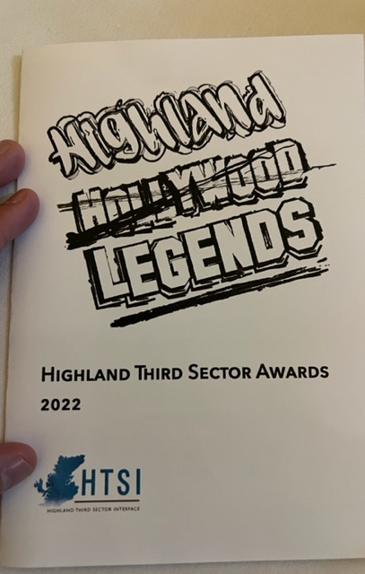
HTSI Awards Ceremony
Huge congratulations to Tilly Grist for winning Volunteer of the Year with the HTSI for all her Hard work over the years.
Tilly has volunteered with us at Cromarty Youth Cafe and has volunteered at more activities, projects and sessions than I could fit on this report When Tilly started volunteering over 5 years ago, she was extremely quiet. Since then, she has become more confident and is very competent.
It has been great to watch her character build into a kind, considerate, caring, helpful and enthusiastic volunteer and leader. She cares about everyone in our community, and she really is an Ambassador for Youth and Community work.
Tilly has played a huge part in voices for young people being heard across the Black Isle, from being on CDCC, Highland Youth Parliament, Cromarty community Rowing Club, and the northern alliance

Slide 4
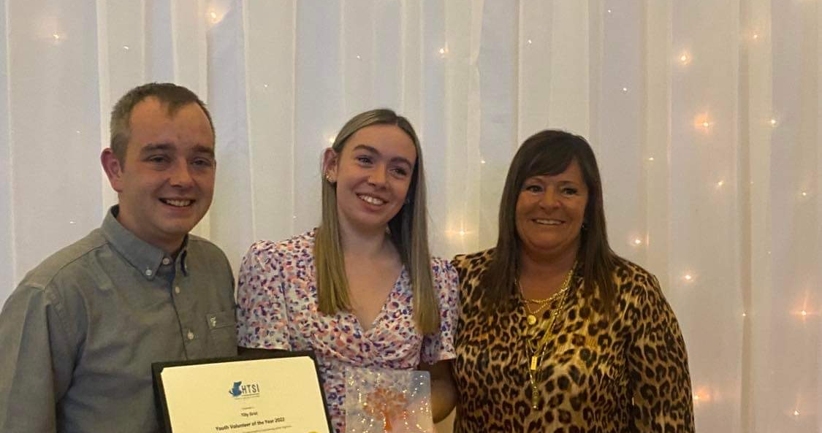

Slide 5
Junior Youth Café
Each week at Junior Youth Café we provide different activities,
Sporting Activities
Arts & Crafts
Cooking & Baking

Slide 6
1-1s
Emotional Check-ins 12 young people that we work with have lost a parent in the last year, this has had a huge impact on these young peoples lives
Building confidence
Supporting YP to take part in driving theory test
Supporting YP to take part in school subjects
Listening to young peoples fears about leaving school and transitioning in the world of work, or moving out of area to attend university
Supporting YP to sign up for Young Carers
Working with Ukrainian Family who have just moved into the area

Slide 7
Football Training with ICT Youth Development
We have been working with ICT Youth Development since last summer,
Young people are learning about ball control, passing skills and shooting,
The improvement in the young people is amazing,
The coaches enjoy coming to Cromarty each week to deliver football coaching.
The ICT football coaches have been skilling up our young leaders teaching them new skills and games

Slide 8
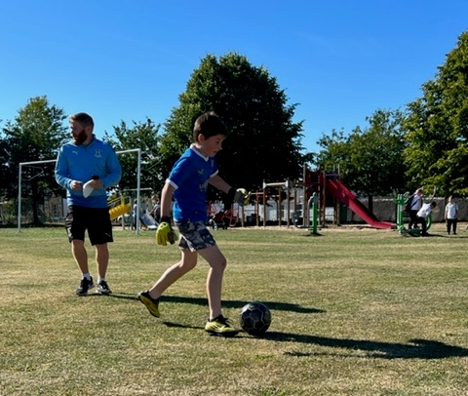
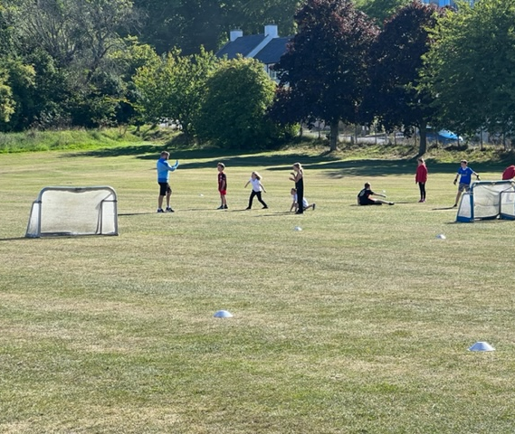
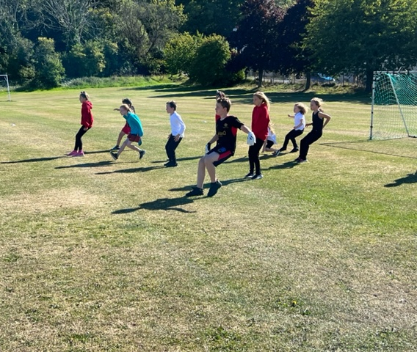
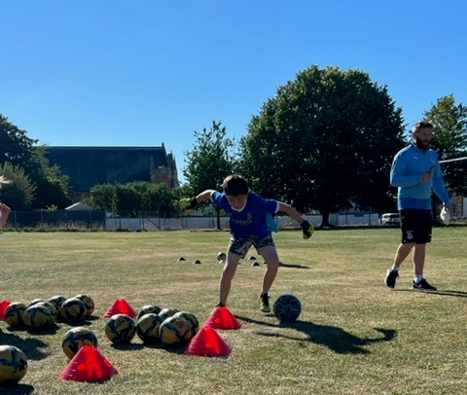
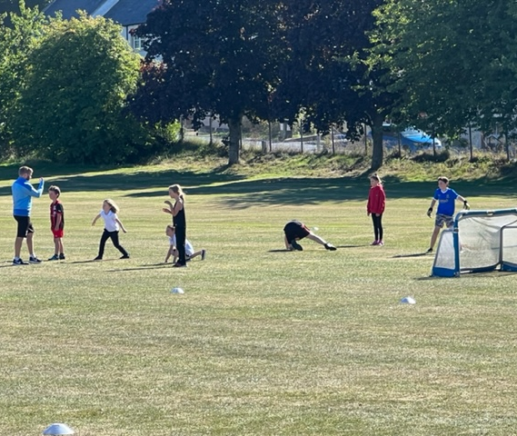
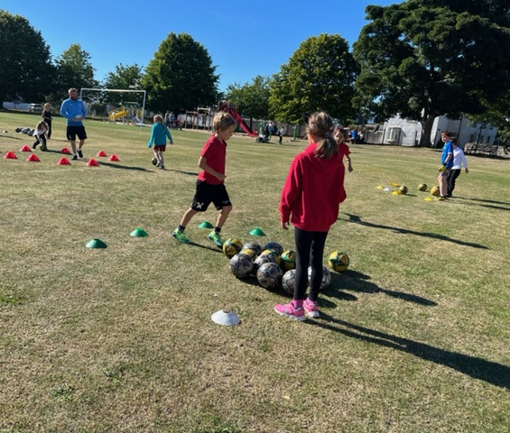

Slide 9
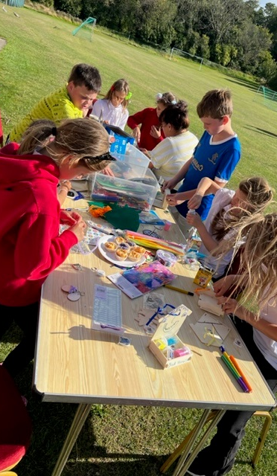
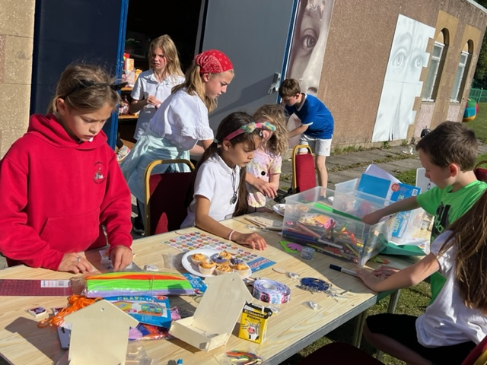
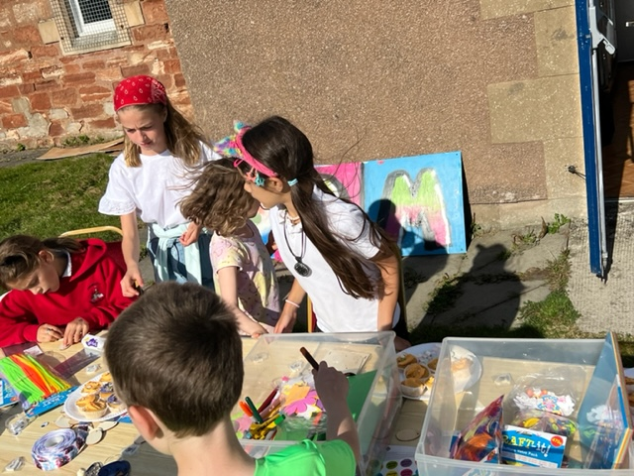

Slide 10
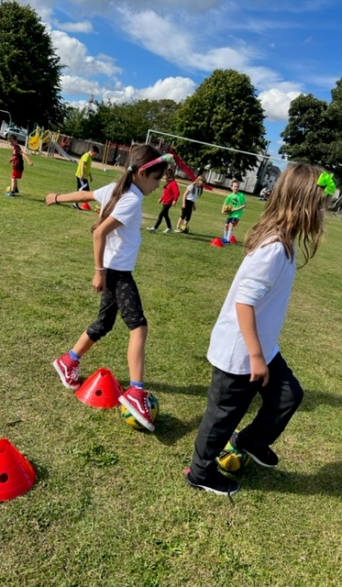
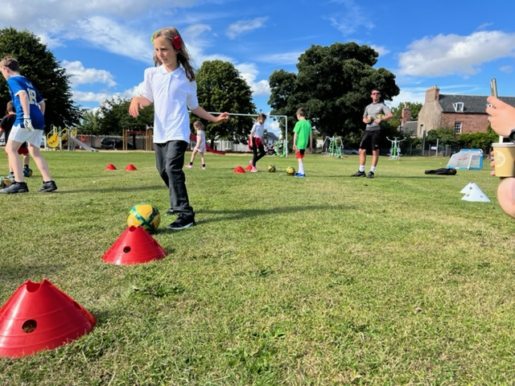
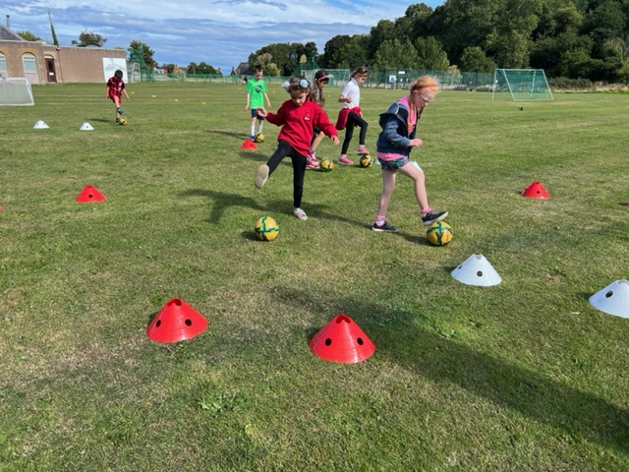

Slide 11
Saltire Awards & HLH Leadership Awards
Over the past Month, we have been tracking and monitoring young people who are taking part in Saltire Award & Highlife Highland Leadership programme.
A number of different awards have been presented to young people for there hard work.
Saltire Awards on the Black Isle – 232 young people taking part in Saltire Awards in the last 2 years they have volunteered over 61,000 hours.
HLH Leadership on the Black Isle – 54 Young people are taking part in HLH Leadership programme, in the last 2 years they have give over 4,500 hours of leadership to the community.
Although these numbers are for the whole Black Ilse, a number of the young people are from Cromarty

Slide 12
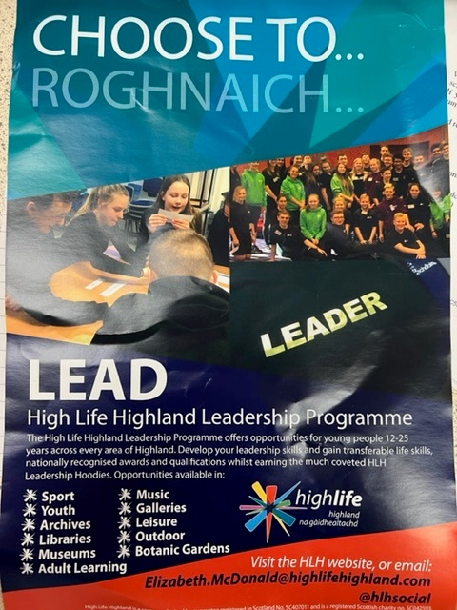
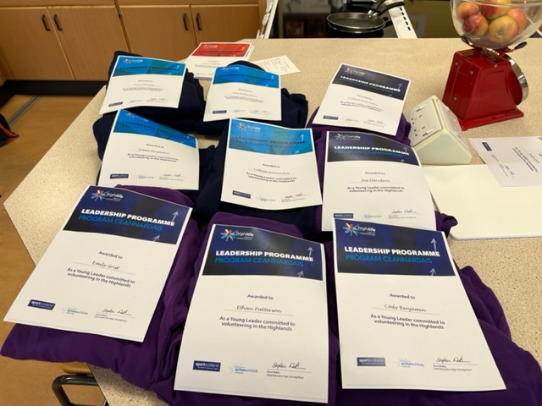

Slide 13
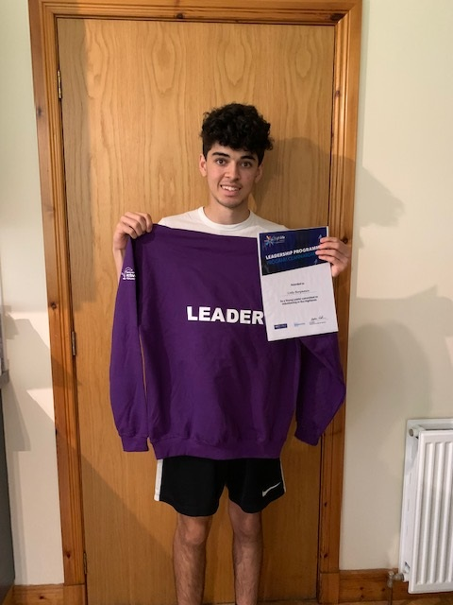
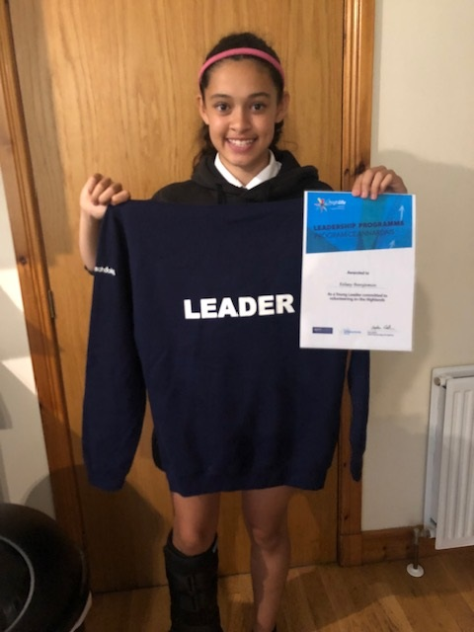

Slide 14
Monday’s Multi-Sports
Every Monday night, this is led by Young leaders
The young leaders are working toward Their Choose Lead Level 4 with High Life Highland
Young leaders plan , deliver and then review the session
The plan is always delivered around what young people want,
Each week young people are playing new games and are working on different skills, such as team work, throwing and catching, & communication skills

Slide 15
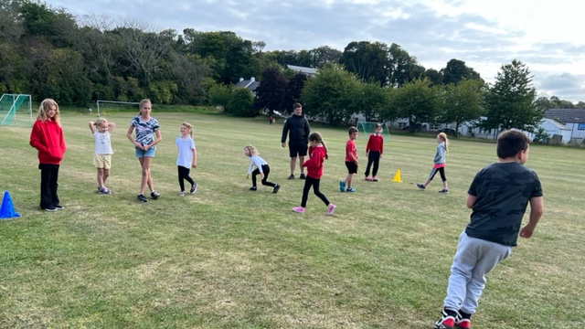
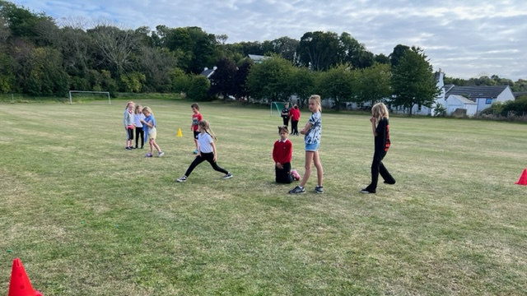
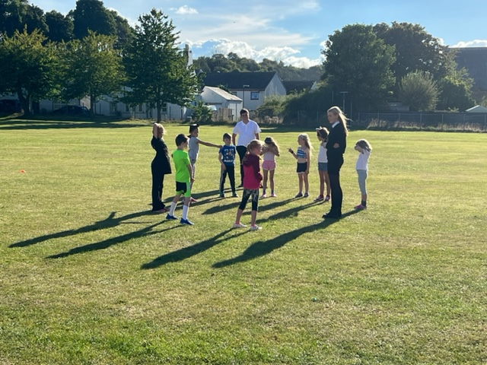
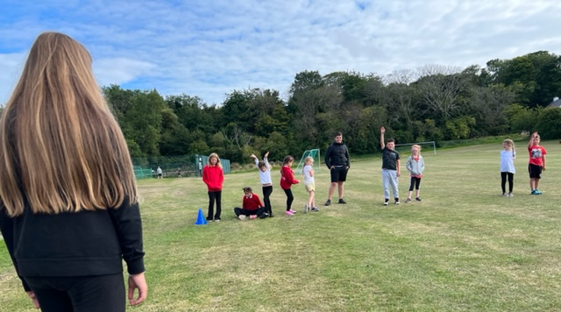
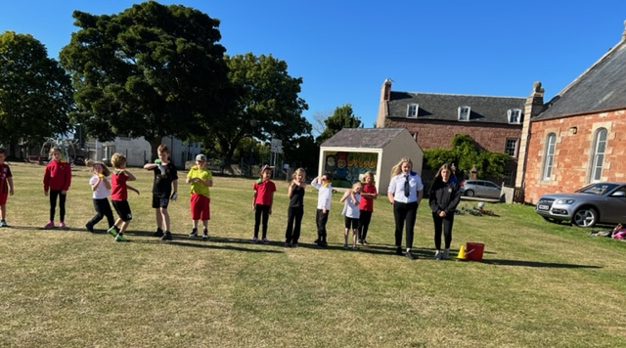

Slide 16
FOOD
With Funding form MFR Cash for Kids, Highland Council Food + Grant, Black Isle Ward Discretionary budget at every activity provided for young people they have the opportunity have a fresh wholesome meal and snack.
Families are telling us about the food and fuel poverty they are in before the winter months.
Young people are consulted as to what they would like to make / eat at each activity.

Slide 17
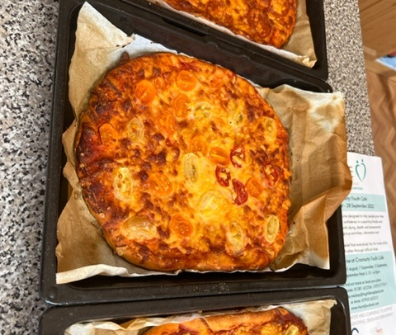
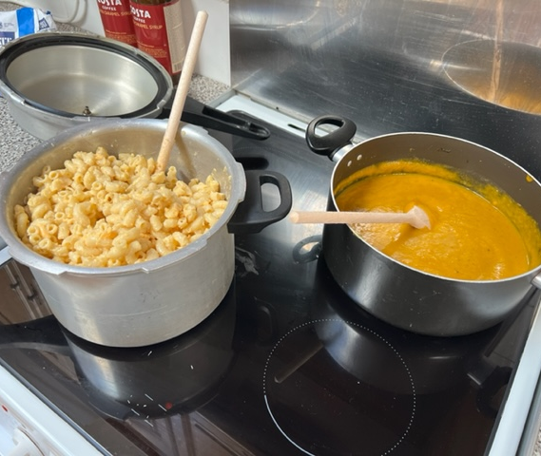
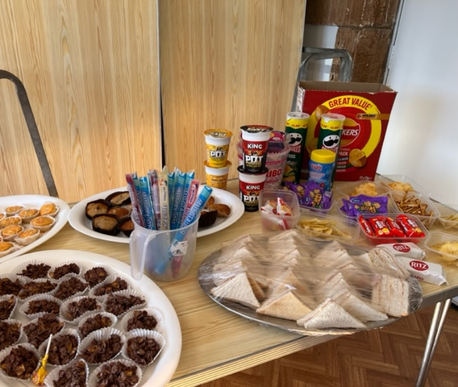
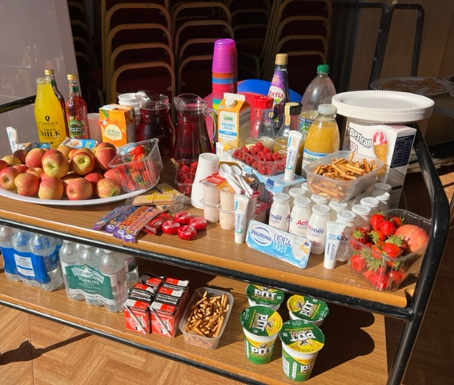
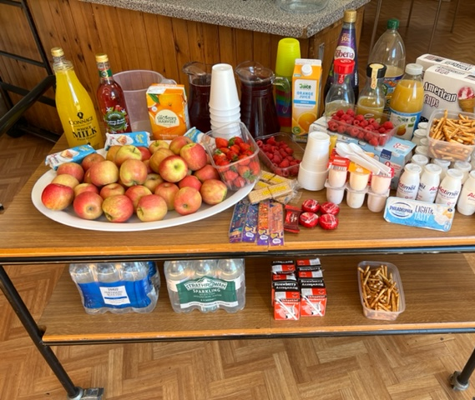
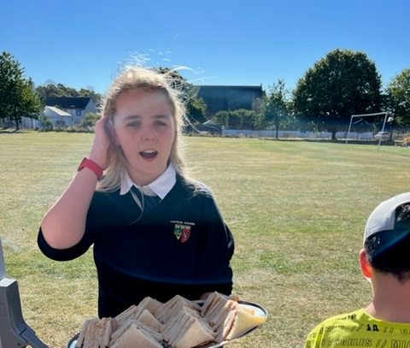

Slide 18
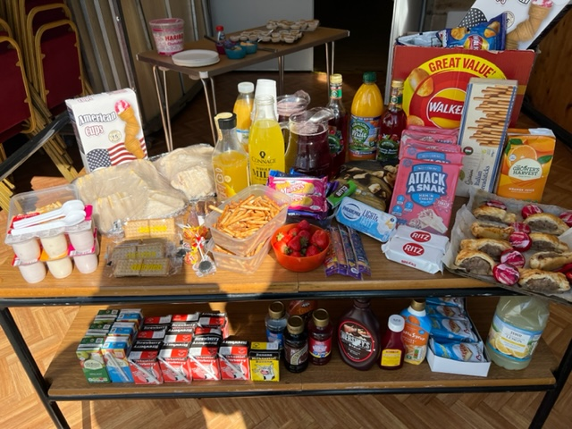
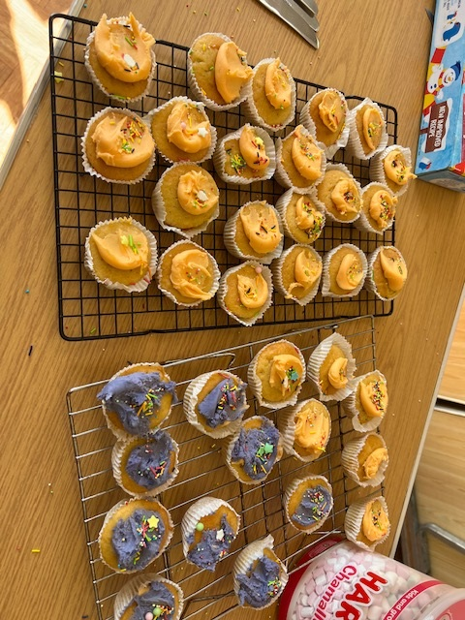

Slide 19
Partners we work with
Highlife Highland –My Future , My Success
Highland Council – Modern Apprentice Team
Fortrose Academy
Cromarty Primary School
CFINE
Cromarty Fire & Rescue Service
NHS
Primary Mental Health
Police Scotland

Slide 20
VR Headset with Cromarty Fire & rescue Service
Great Session with Ronald young, Laura Paterson, Dean McFadden from Scottish Fire 🔥 & Rescue Service with VR Headsets road safety course 👩‍🚒

Slide 21
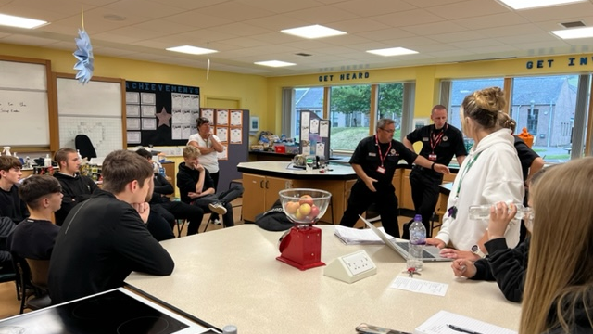

Slide 22
Food safety at work training
Young people have been working their way through the courses, and have been learning about good hygiene, and correct ways to store food.
This will enable young people to cookwell, Bakewell , Eatwell and in turn Livewell
35 young people have passed their Level 1 Food Safety at work
3 staff members have passed their Level 1 Food Safety at work
7 young people are near to completion of their Level 1 Food Safety at work
25 young people have passed their Level 2 Food Safety at work
3 staff members have passed their Level 2 Food Safety at work
20 young people working their way through the course
Level 1 takes approx. 4 hours to complete
Level 2 takes approx. 6 hours to complete

Slide 23
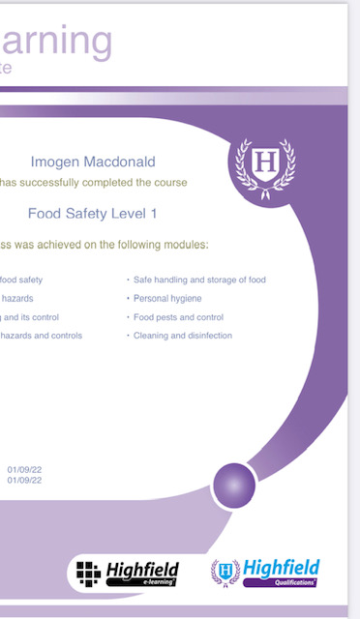
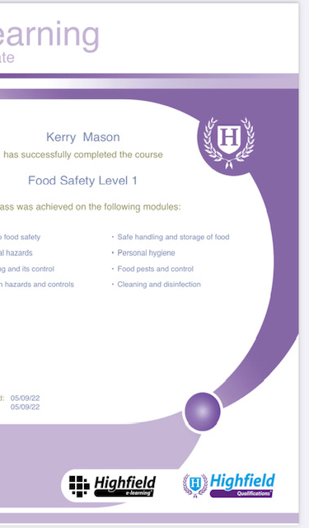
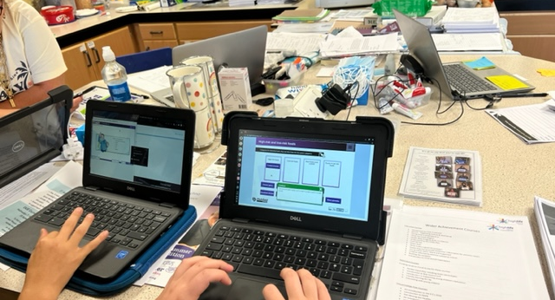
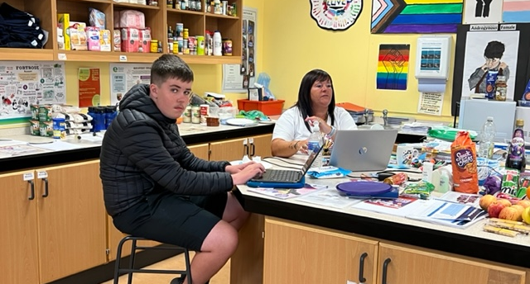

Slide 24
Ease Course
Interactive and informative sessions at Cromarty Youth Cafe taking part in the (EASE) course End of Life Skills for Everyone with Caroline from the Scottish Partnership for palliative care and Anne from HSCN
Discussing the types of questions to ask health professionals, especially when things are difficult feeling confident you can ask for things to be explained using clear and simple terms . How to be a good support in difficult times but mindful of boundaries
Group conversations about how to help a loved one when they have had a diagnosis Great Intergenerational session learning how to build comfort and confidence to support people through dying death and bereavement
#goodlife
#gooddeath
#goodgrief

Slide 26
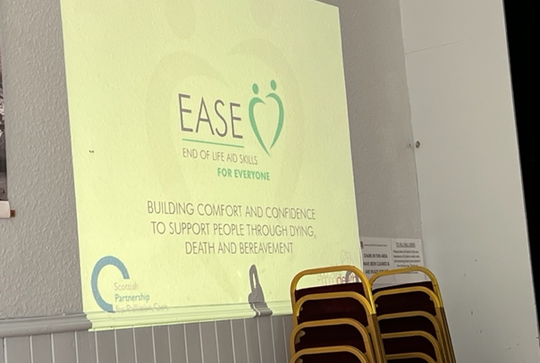
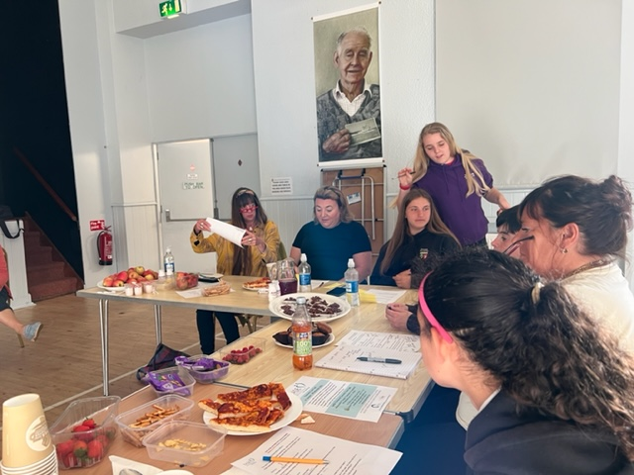
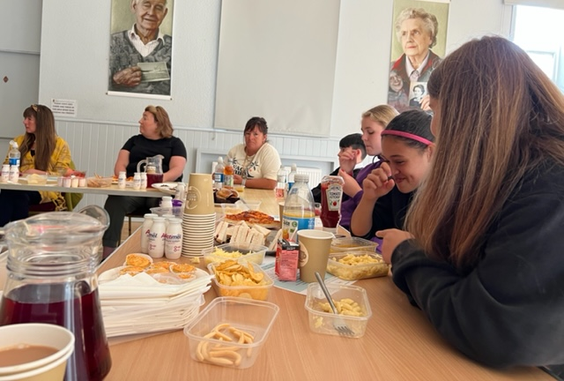

Slide 27
Cfine Deliveries
After receiving our CFINE Delivery, the youth café created food parcels and then delivered the parcel to vulnerable members of the community.

Slide 28
Rowing
Weekly sessions,
Planning with young people looking at the rowing timetable and working out when the boat was available so they could get extra slots outwith there usual slot to be able to practise for the up and coming regatta.
The enjoyment the young people get out of being on the water is incredible.
Young people were practising on there timing and form for rowing, Learning about, Wind, Weather, Tides enabling young people to be come safe at sea

Slide 29
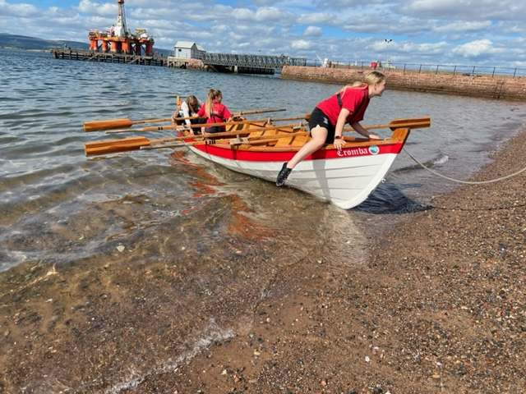
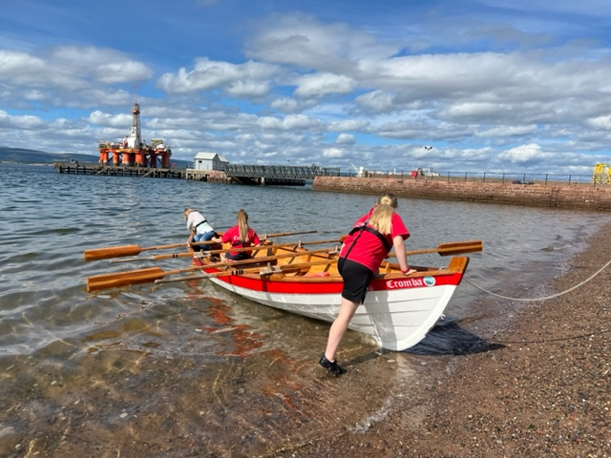
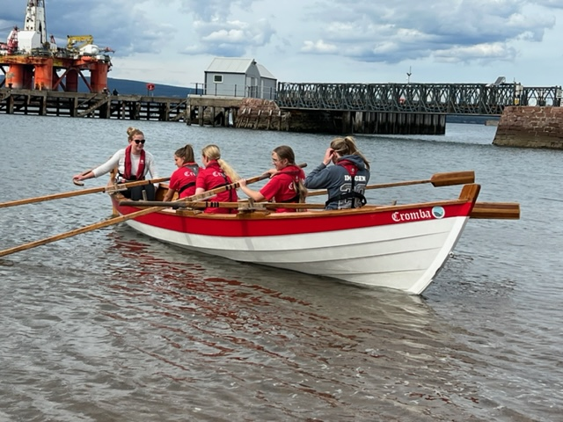
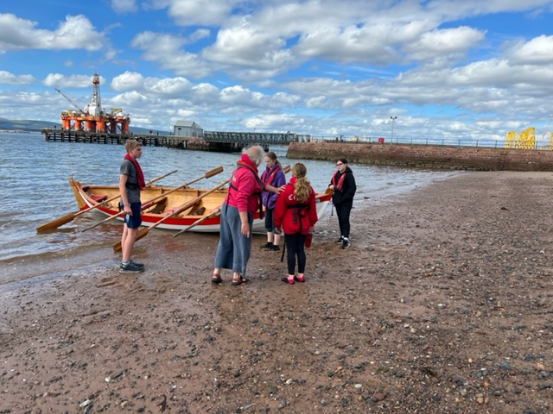

Slide 30
Rowing Regatta
Cromarty Regatta on 17th & 18th September 2022
All our Youth Teams won medals at the regatta,
Under 15 Girls – Gold
Under 15 Girls – Bronze
Under 15 Boys – Bronze
Under 18 Girls – Gold
Under 18th Boys – Bronze
Fantastic rowing from all teams and the teams on the Saturday with the super choppy conditions, they really do make us all proud.

Slide 31
Rowing Regatta cont
For the regatta
Young people spent all Friday afternoon setting up links, cordoning of the park,
Greeting rowers when they arrived in the community
Collecting money from the campsite
Ensuring the area was kept clean and tidy, collecting rubbish
Decorating Slates for each club and working out there placing on the shore.
MC’ing for the two days of the regatta and believe me they were amazing and they could be heard at the other side of the town.
the amount of hours volunteered for the regatta was incredible.

Slide 32
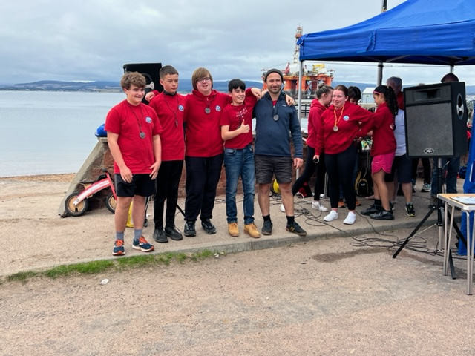
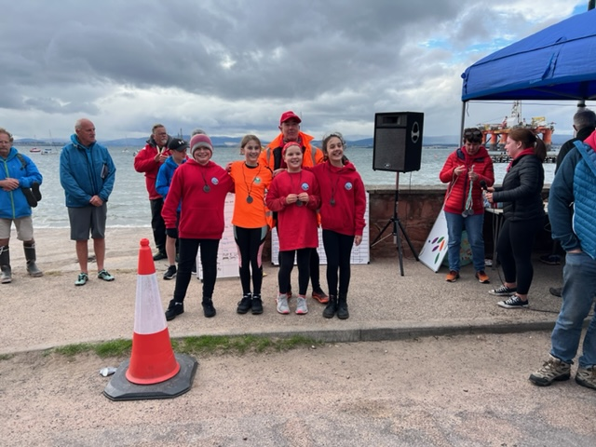
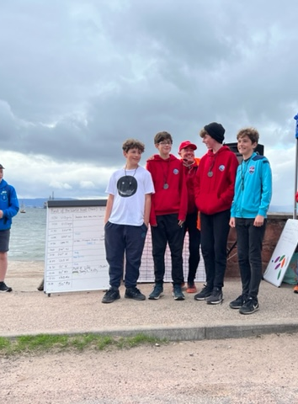
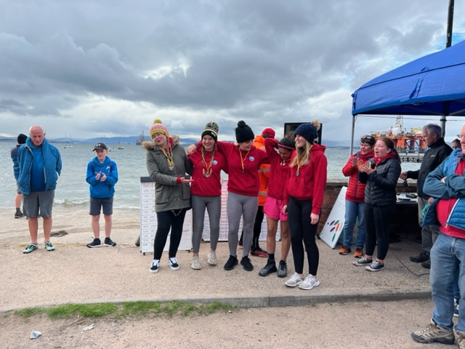

Slide 33
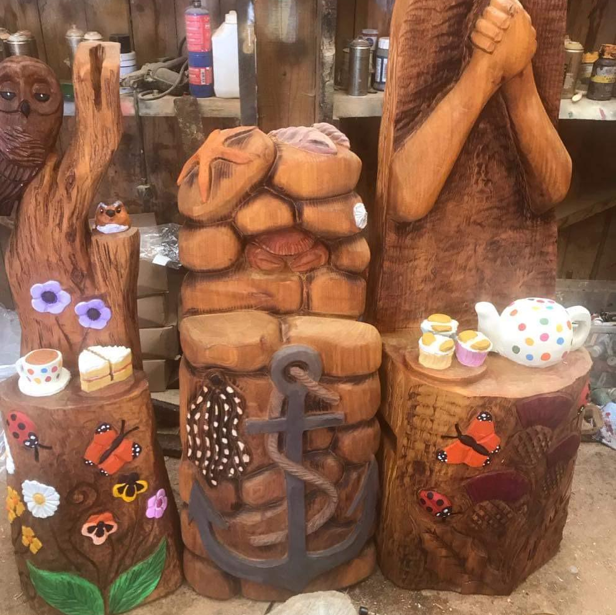
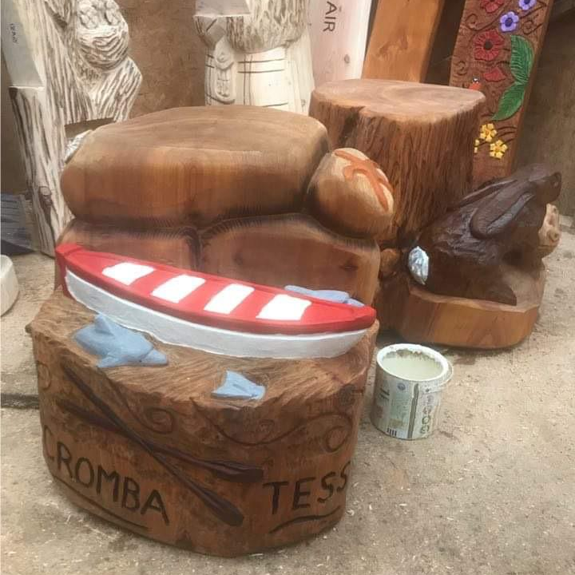
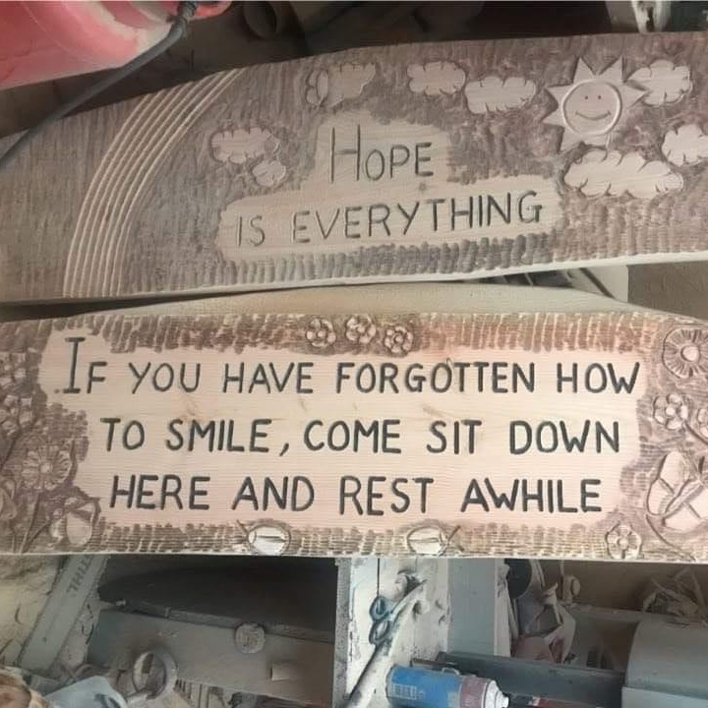
Legacy Bench / Reflection Bench
This Buddy Bench will be a lasting symbol of our intergenerational support, respect and understanding of others in the community.
We are hoping to have an opening ceremony on the 10th October 2022

Slide 34
Voices of young people
Over the last month we have been busy working with young people who are on participation forums enabling the voices of young people to be heard.
Huge Welcome to Dominic Scott-Lodge as our new youth member for Cromarty Community Council
Huge Welcome to Emily Grist and Katherine Holm who are our new reps for Highland Youth Parliament.

Slide 35
Planning Ahead
Working with Julie from the Development Trust to support young people to sign up for the FREE bus Travel – the uptake for highland is only at 30%
October Programme
Creativity in Care Workshop
Installation of the Reflection Bench

